Slide 1



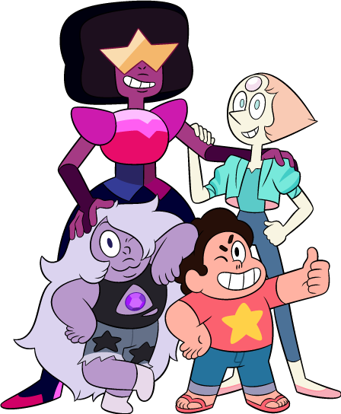
Digital Lesson #1
Tool to Build Up Body Confidence
Notes:
Video Note:
If a Security Warning about external media appears, click Enable Content. This will allow the videos to play.

Slide 2
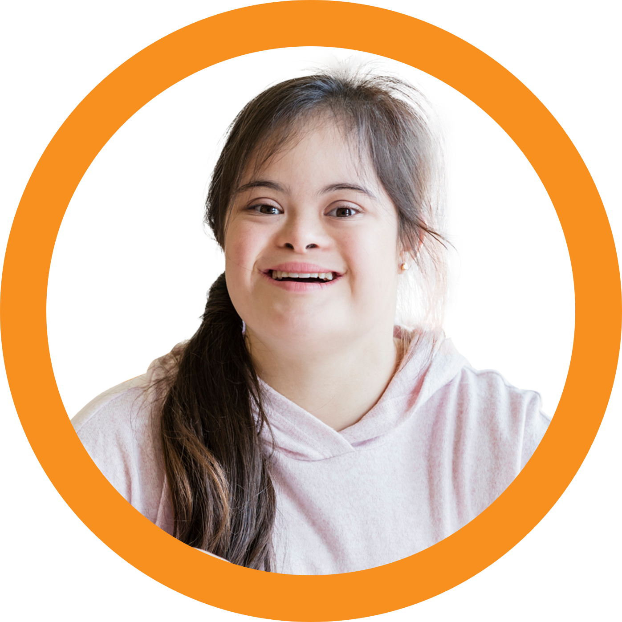
We are going to talk about our bodies.
How do we create a safe, respectful, and kind space?
Session 1
Today…
Notes:
Teacher Notes:
Engage pupils in establishing “ground rules” for discussion by asking them, “how do we create a safe, respectful, and kind environment for conversations about our bodies?”
Examples might include: listen respectfully, no interrupting, question ideas without criticising people, no insults, give everyone a chance to speak, etc.
Write responses on the board and keep them there through the duration of the series.
When needed, refer to the pupils’ ground rules as a reminder of how important it is to respect one another in these sensitive conversations.

Slide 3
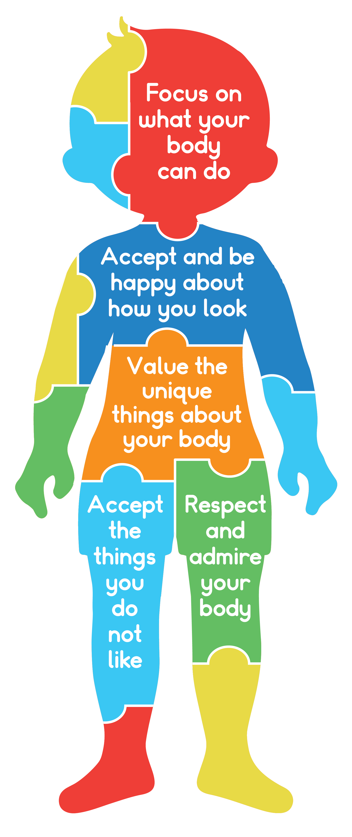

Body Confidence
Session 1
Body Confidence: how a person feels about the way
they look.
Notes:
Teacher Notes:
Introduce pupils to the concept of body confidence or the sense of love and respect for our body and what it can do.
Body confidence looks like:
Appreciating the unique things about our body and what it can do for us
Accepting and admiring our body, even parts that don’t look like what the media says is “ideal”
Feeling beautiful, comfortable, confident and happy in your body
Focusing on what your body can do instead of what it can’t do
Being a smart consumer when it comes to messages about our bodies: accepting positive messages and rejecting or reframing negative messages
Wood-Barcalow, et al., 2010; Tylka & Wood-Barcalow, 2015

Slide 4
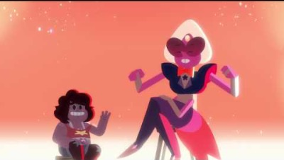
Comparisons
Session 1
Notes:
Video Note:
If a Security Warning about external media appears, click Enable Content. This will allow the videos to play.
Teacher Notes:
Inform pupils that one thing that can damage their body confidence is comparing themselves to others.
Click to show the video Competing and Comparing Looks.
After showing the video, consider asking the class one or more of the following questions:
How does Smoky Quartz feel when she begins comparing herself to Sardonyx?
(Anticipated responses might include: she begins to feel upset about her body and her appearance, she begins to feel like her body is not as good as Sardonyx’s body, etc.)
What helped make Smoky Quartz feel better after she was upset?
(Anticipated responses might include: she realised that everyone’s body is unique but doesn’t make one better than another; everyone’s body has different and special qualities; Smoky Quartz can do special things with her body, and Sardonyx can do special things with her body; etc.)

Slide 5
Agree or Disagree
Session 1
Smoky Quartz was upset after she compared
herself to Sardonyx.
I can relate to how Smoky Quartz felt in the video.
I compare myself to others.
Comparing myself to others is bad for me.
I can think of some things I love about my body.
I can help my friends to like themselves more.
All bodies are great bodies.
Notes:
Teacher Notes:
Explain to pupils that they will see a series of statements appear on the screen. If they AGREE with the statement, they should stand up/stay standing. If they DISAGREE with the statement, they should sit down/stay seated.
Click to reveal the first agree/disagree statement, “1. Smoky Quartz became upset after she began comparing herself to Sardonyx.” Ask pupils to stand or stay seated.
Click again to reveal the second agree/disagree statement, “2. I can relate to how Smoky Quartz felt in the video.” Ask pupils to stand or sit.
Click a third time to reveal the next agree/disagree statement, “3. I compare myself to others.” Ask pupils to stand or sit.
Click a fourth time to reveal the next agree/disagree statement, “4. Comparing myself to others is bad for me.” Ask pupils to stand or sit.
Click a fifth time to reveal the next agree/disagree statement, “5. I can think of some things I love about my body.” Ask pupils to stand or sit.
Click a sixth time to reveal the next agree/disagree statement, “6. I can help my friends to like themselves more.” Ask pupils to stand or sit.
Click a seventh time to reveal the next agree/disagree statement, “7. All bodies are great bodies” Ask pupils to stand or sit.
Distribute one When I Compare handout to each pupil. Encourage pupils to think carefully about how comparisons make them feel as they complete their own story.
Note: If pupils struggle to complete this handout independently, consider working through it as a whole class or in small groups using information from the discussion and the video to help fill in the blanks.
If there are pupils who would like to read their stories, allow them to do, and facilitate brief reflection after each one, connecting back to their learning in the session.

Slide 6
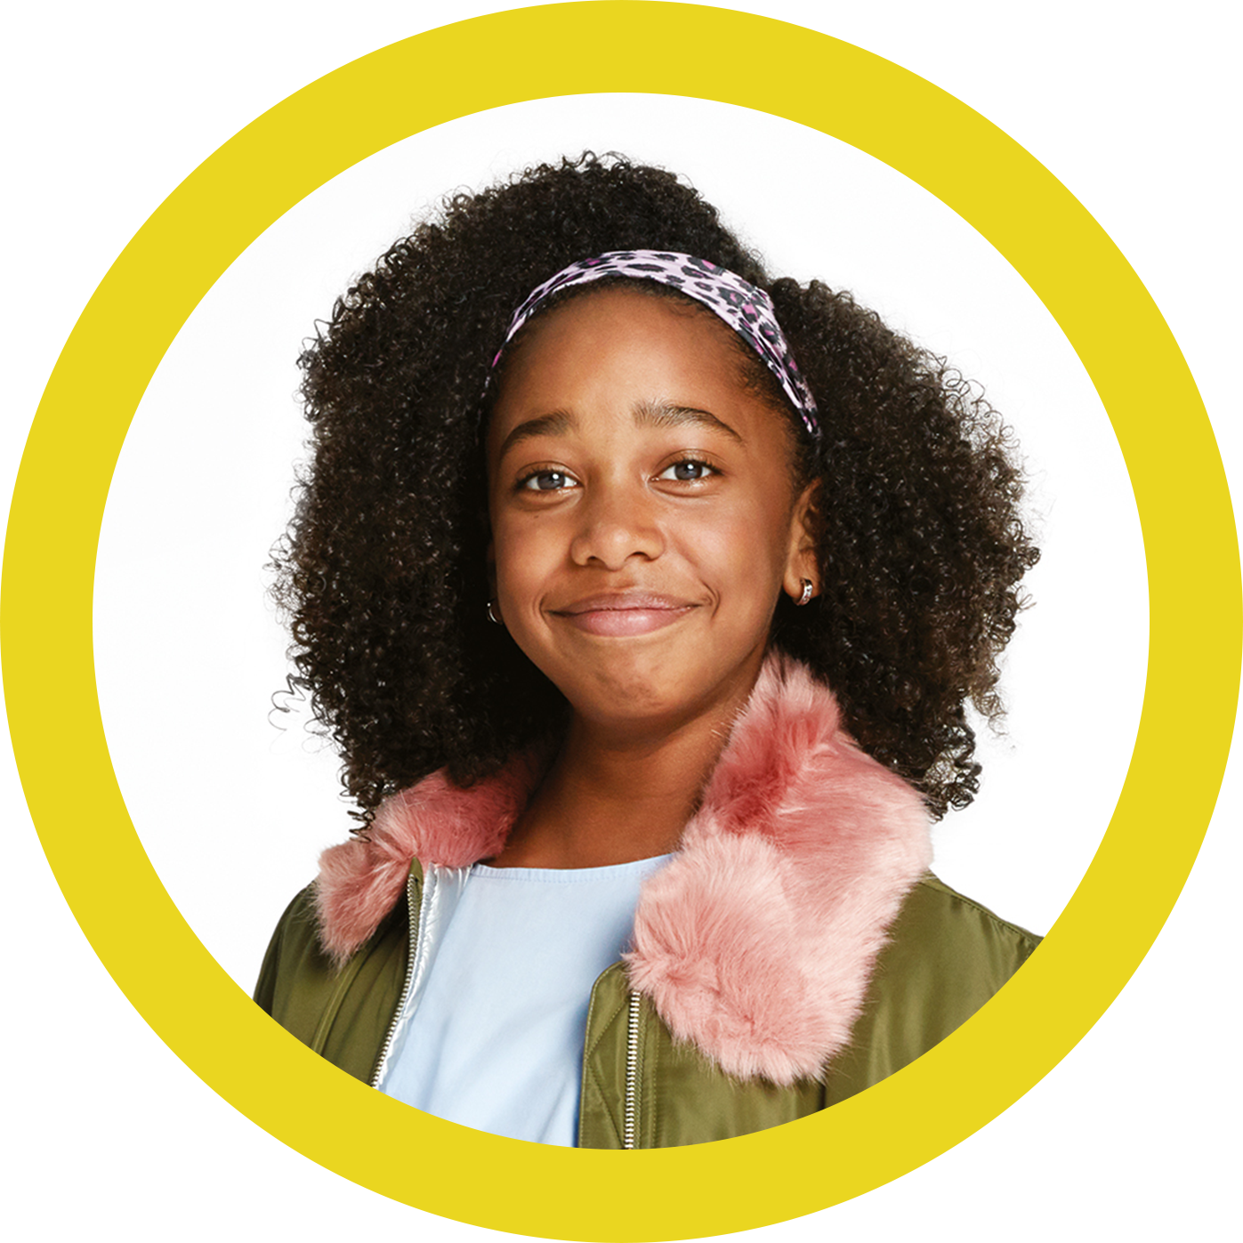
Why Do We Compare?
Session 2
Our society tells us there is the ideal way to look at a certain moment in time. This is an ‘appearance ideal’.
Remember:
They are impossible to achieve.
They are based on opinions.
They are always changing.
They are unrealistic.
Notes:
Teacher Notes:
Begin session by reinforcing what pupils learned about body comparisons and the effects they have on body confidence.
Inform pupils that comparing themselves to friends and family happens a lot, but society can too. Society can promote the ‘ideal’ way to look at a certain moment in time. This is called the ‘appearance ideal’.
Click to show pupils the following things they should remember:
They are impossible to achieve.
They are based on opinions.
They are always changing.
They are unrealistic.
Encourage pupils to remember that the way they look isn’t a measure of how much they are worth. They can focus on other qualities and skills they have, how they feel, and what their bodies can do. This is called the ‘healthy ideal’.
https://www.dove.com/content/dam/unilever/dove/global/english/personal_care_unidentified/all/appearance_ideals_-_student_activity_sheets-717945.pdf

Slide 7
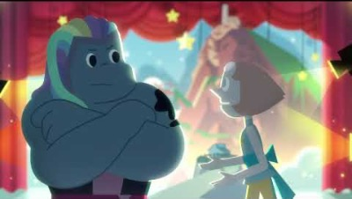
Body Talk
Session 2
Notes:
Video Note:
If a Security Warning about external media appears, click Enable Content. This will allow the videos to play.
Teacher Notes:
Let pupils know that one way to avoid comparing and competing looks is to avoid body talk.
Click to show the video Body Talk.
After showing the video, consider asking the class one or more of the following questions:
What are some of Bismuth’s skills?
(Anticipated responses might include: loyalty; strength; can turn hand into a saw and cut things; can build and paint things with her hands; etc.)
How can body talk be harmful or upsetting?
(Anticipated responses might include: uncomfortable or embarrassing; can make someone think they have to look a certain way; cause comparisons; make someone change the way they look to please others; etc.)
Engeln, R., Sladek, M. R., & Waldron, H. (2013). Body talk among college men: Content, correlates, and effects. Body Image, 10(3), 300-308

Slide 8
How Common is Body Talk?
Session 2
Have you ever talked about how someone looks?
Hands Raised | # of pupils | Percentage
1 | 1 | 100%
Notes:
Teacher Notes:
Explain to pupils that we are going to practise detecting and stopping body talk. This can avoid the negative consequences of talking about physical appearance.
Ask pupils to raise their hands if they’ve been part of a conversation about someone’s physical appearance in the past week.
Count how many pupils raise their hands and calculate the percentage of the class this represents by entering numbers on the slide (# of hands raised / total # of pupils x 100). Click to reveal the percentage.

Slide 9
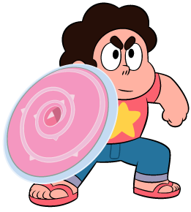
Flip the Script
Session 2
What are some problems with
body talk?
What other topics can we talk about that are not about how we look?
Notes:
Teacher Notes:
Reinforce that even positive body talk can have negative consequences. Ask 1-2 volunteers to share why they think that might be. Anticipated responses might include:
You’re still focusing on how someone looks.
You might be reinforcing the appearance ideal.
Someone who doesn’t hold that quality might start comparing.
You’re implicitly comparing yourself to whoever you are talking to/about.
Discuss with pupils how body talk is common and explain that sometimes we do not realise we are engaging in body talk. We are going to practise stopping body talk when we realise it is happening.
Challenge pupils to brainstorm topics of conversation that do not revolve around bodies or how people look. Some examples include sports, school, music, family, pets, etc. Record as many ideas as pupils can think of in five minutes on the board.

Slide 10
Practice: Flip the Script
Session 2
Partner A:
Who do you think is the
best-looking kid in our class?
Partner B:
Did you see his muscles?
How does he get so strong?
Partner A:
Did you lose weight?
You look good.
Partner B:
I hate my hair!
Notes:
Teacher Notes:
Virtual Facilitation Options:
Have pupils find a partner—one pupil should be “Partner A” and one should be “Partner B.” Inform them that a series of scripts will appear on the screen. The assigned person should read the script while the other partner needs to think of a way to “flip it” by talking about something other than appearance.
(Anticipated responses to each example might include: What is your favourite sport to play? Who do you think is the best artist in our class? I’m worried about our math test; who do you think I should work with? I like that everyone is unique and looks different. Isn’t it cool that we all have different things we’re good at?)
Click to reveal the first script, “Who do you think is the best-looking pupil in our class?” Provide 1-2 minutes to discuss. Remind pupils that the objective is to talk about something else and to stop talking about appearance.
Click to reveal the second script, “Did you see his muscles? How does he get so strong?” Provide 1-2 minutes to discuss.
Click to reveal the third script, “Did you lose weight? You look good.” Provide students 1-2 minutes to discuss.
Click to reveal the final script, “I hate my hair!” Provide students 1-2 minutes to discuss.

Slide 11
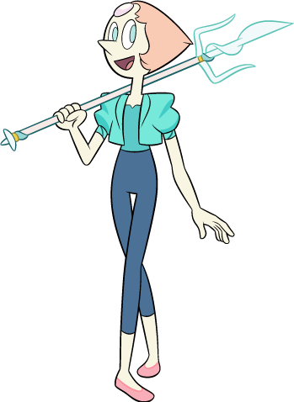
How did it feel to flip the script?
Session 2
Let’s Reflect
Notes:
Teacher Notes:
Reflect on pupils’ learning by asking them how it felt to “flip the script.” What was their first reaction when they heard the questions? How did it feel to not participate in body talk? In the future, what are some things you feel comfortable doing to stop body talk?

Slide 12
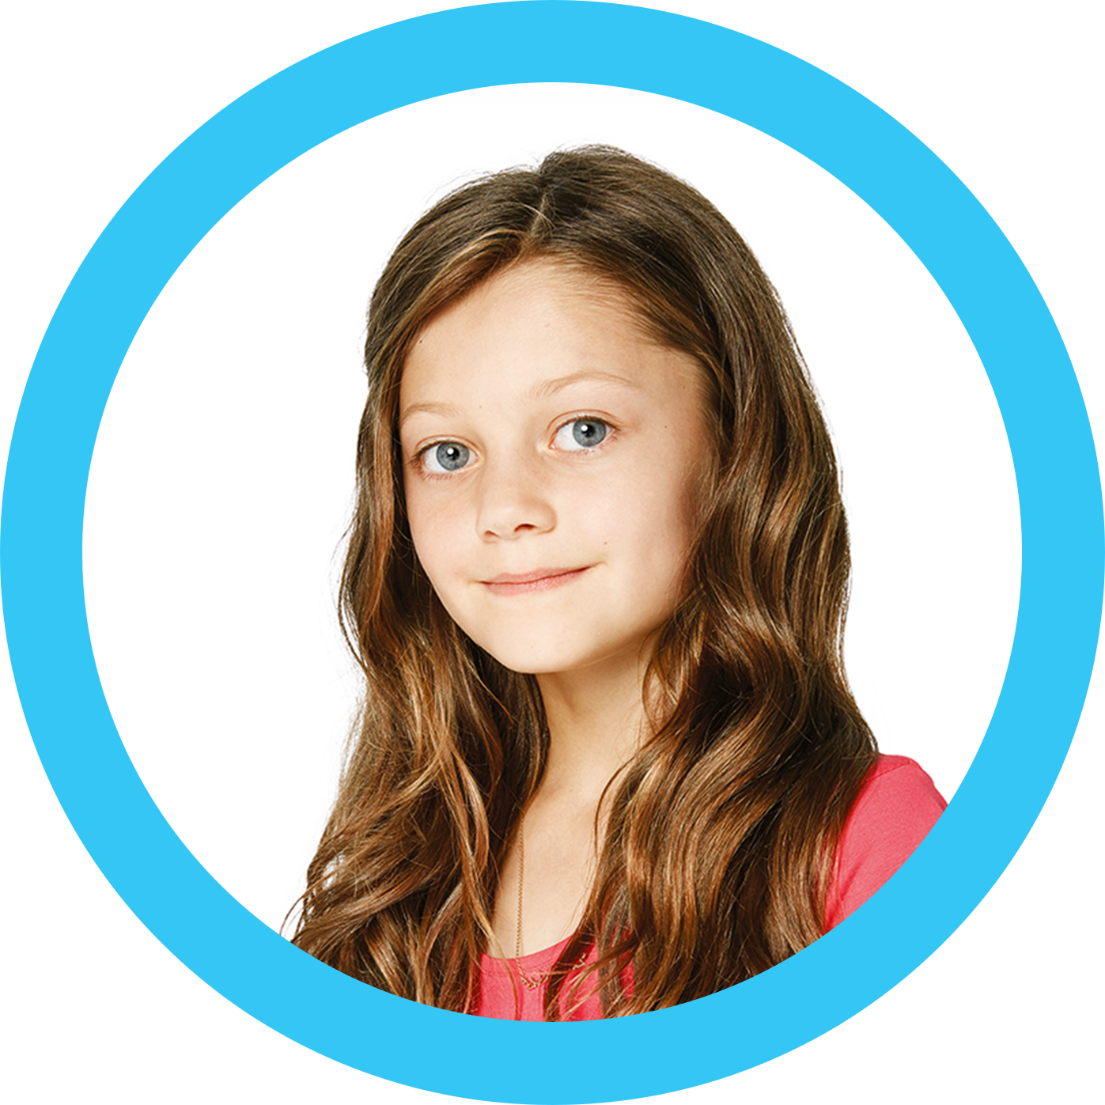
Let’s Review
Session 3
What is body confidence?
Why is comparing to others bad?
What is body talk?
Notes:
Teacher Notes:
Reinforce pupils’ learning thus far by asking the following questions. Write their responses on the board, addressing any misconceptions as they arise.
What is body confidence?
Why is comparing to others bad?
What is body talk?

Slide 13
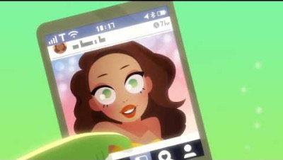
Media & Celebrities
Session 3
Notes:
Video Note:
If a Security Warning about external media appears, click Enable Content. This will allow the videos to play.
Teacher Notes:
Explain to pupils that one of the most detrimental ways to let body comparisons affect their confidence is to compare themselves to images they see in the media. This is because their images are often unrealistic for example it is common to “touch up” images or encourage habits that might not be healthy.
Click to show Media & Celebrities video.
After showing the video, consider asking the class one or more of the following questions:
What predicament does Peridot find herself experiencing in the video?
(Anticipated response might include: she loves her tablet but realises it makes her feel bad about the way she looks because the internet features unrealistic expectations for people.)
In what ways do you think the media sets unrealistic expectations for our bodies?
(Anticipated responses might include: female models featured in the media are usually very tall and thin; male models tend to be tall and muscular; models for both genders are usually able-bodied; etc.)
Why do people use filters or photo editing apps to change or touch up photos? Why might this be problematic or make consumers feel badly about themselves?
(Anticipated responses might include: people touch up photos to look better; to hide the things they don’t like about themselves; it makes people feel bad because you feel how you look is not good enough; you compare yourself to people on photos that are not real; etc.)

Slide 14
Body Dissatisfaction
Session 3
What does dissatisfaction mean to you?
Type here…
Notes:
Teacher Notes:
Ask pupils what they think body dissatisfaction means. After discussing, ensure pupils understand that body dissatisfaction is negative perceptions and feelings a person has about their body. Discuss how comparing ourselves to images in media can lead to body dissatisfaction.
Challenge pupils to brainstorm things that could make us experience body dissatisfaction or feel unhappy with how we look. Record responses in box on the slide. (Anticipated responses might include: our weight, wanting our bodies or body parts to look a certain way, the changes the body go through during puberty, our height, etc.)
Discuss how body dissatisfaction can lead to negative thoughts, feelings, and behaviours.
Explain that today the class will be creating positive thoughts cards that they can reference when they experience feelings of body dissatisfaction. Positive thoughts are good or encouraging thoughts that pupils can read or say when they are having negative thoughts about themselves.

Slide 15
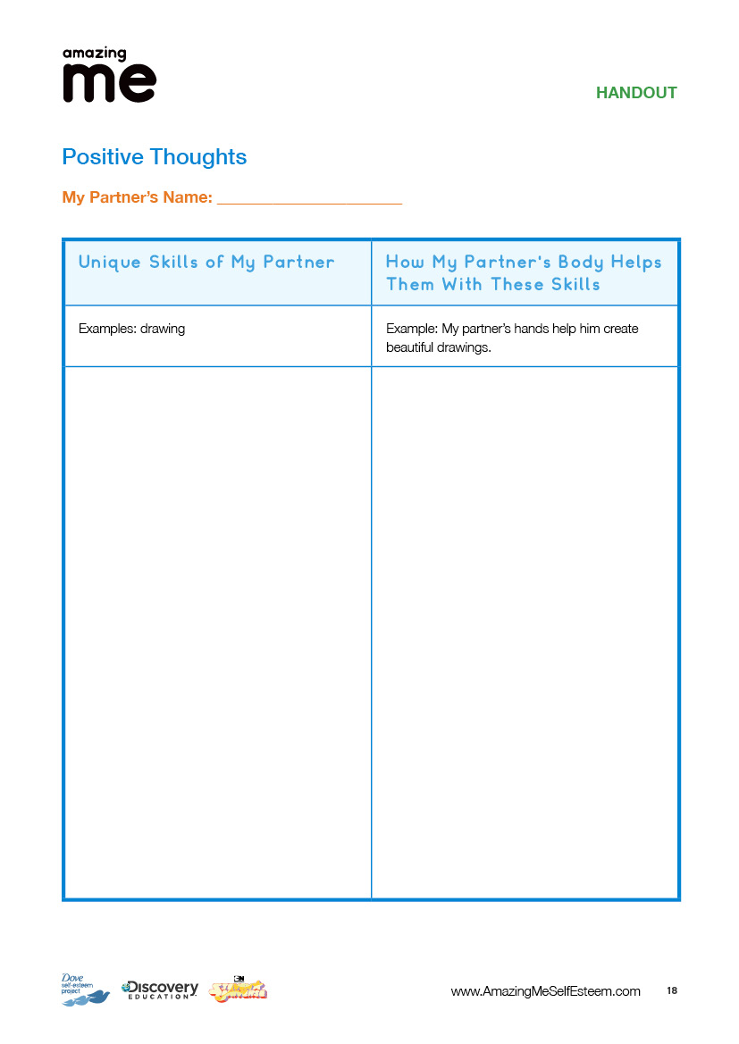
Positive Thoughts
Session 3
Complete the positive thoughts card about your partner.
  Include unique skills such as hobbies
  or sports.
  Include things you are good at like reading or drawing.
  Include special things you can do
  with your body.
Then describe how your body allows
you to do each thing. ‘My eyes allow me to read’.
REMEMBER: BE POSITIVE!
Notes:
Teacher Notes:
Ask pupils to find a partner and distribute one Positive Thoughts handout to each pupil.
Ask pupils to fill in each column of the chart about their partner, give them 5 minutes to do this. If they are not familiar with their partner, they can take a few minutes to talk to them about their hobbies, their favorite subjects in school, achievements, etc.
When they have finished, ask pupils to read their positive statements about their partner to that person, starting each point with ‘You are…’ or ‘Your’ (For example: ‘Your hands help you create beautiful drawings.’; ‘Your legs allow you to run fast.’ etc.)
After pupils have completed this process, ask them to collect their own positive thoughts sheets and take a moment to review the comments from their peers.
Explain to pupils that they will now use their Positive Thoughts handout to create cards for themselves.
Distribute the art materials you have chosen to use or remind pupils where to find them in the classroom.
If necessary, model the creation of their Positive Thoughts Cards. Some suggested formats might include:
. writing their name in the centre of the paper and surrounding the name with adjectives, qualities, skills, and unique characteristics.
choosing one ‘You are…’ or ‘Your’ statement read from the Positive Thoughts handout to write in large letters and decorate.
Provide time for pupils to complete their cards. If time allows, they may complete more than one.
Invite pupils to think about some places they can put their card to reference it throughout the day (i.e., inside of locker, tucked in a binder, taped to the mirror at home, etc.).

Slide 16
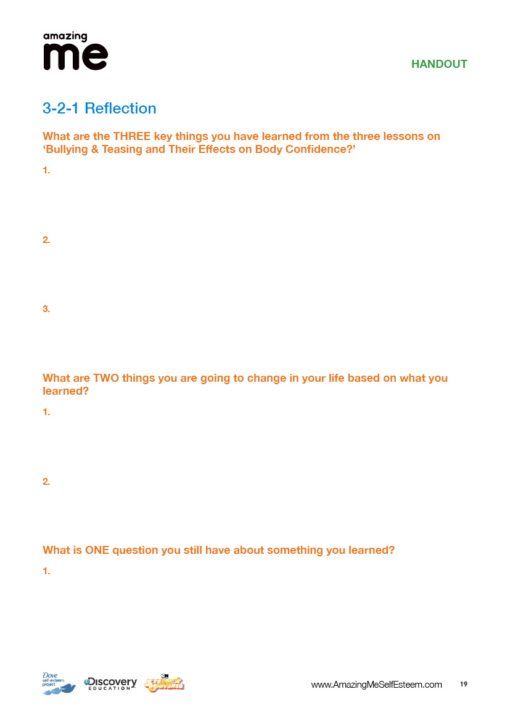
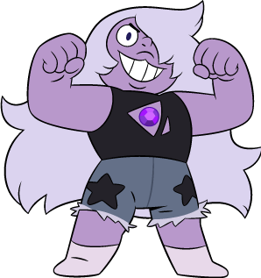
3-2-1
Session 3
Notes:
Teacher Notes:
Virtual Facilitation Options:
Distribute the Reflection handout to each pupil.
Collect the reflection sheets from the pupils. If time allows, choose a few questions that remain and discuss with the group. As you are able, follow up with pupils regarding their reflection after the conclusion of the lessons.

Slide 17
Glossary
Body Confidence: how a person feels about the way they look.
Body Talk: talking about how you look; talking about weight or size.
Positive Thoughts: Positive things you can think or say to yourself.

